Slide 1
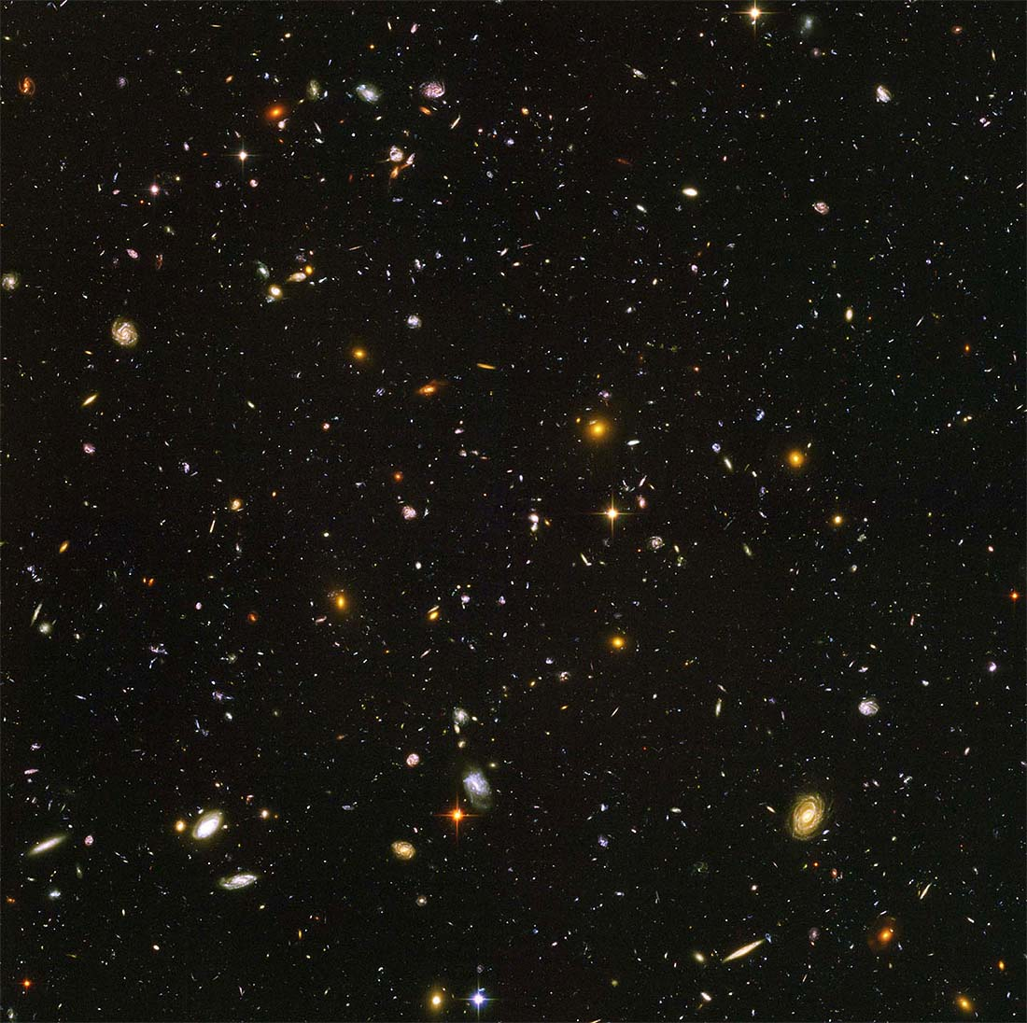

Blahblahblah Something Clever goes here
PRINCIPLE COMPONENT ANALYSIS OF BROWN DWARVES
Colleen Cleary (Hunter College)
David Rodriguez (Advisor)

Slide 2
Blahblahblah Something Clever
Introduction
What is a brown dwarf?
What is in the BDNYC database?
What is a principal component analysis?
Objective
Method
Results and Conclusion
Why is it important?

